Slide 1
Semi-automated Segmentation Pipeline for Analysis of Knee Joint Kinematics
Wissenschaftliches Werner Kaiser-Sommersymposium
AG Med Phys
A comparision with manual based segmentation
Jena | 25.10.2024 | Aayush Nepal

Slide 2
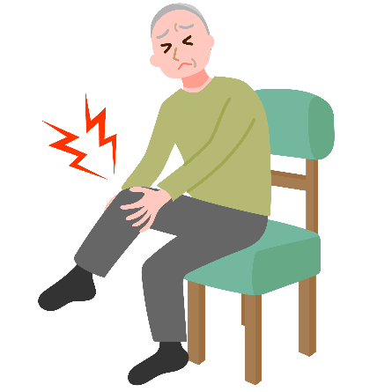
Motivation: Relevance of knee kinematics
Knee osteoarthritis (OA) affects 10% men and 13% of women aged 60 and older (Zhang et al., 2010)
Altered tibiofemoral kinematics in OA patients can potentially accelerate disease progression (Farrokhi et al., 2014)
Even in ACL-deficient knees without instability symptoms, knee kinematics are altered (Yang et al., 2018)
Understanding tibiofemoral kinematics is key to assessing knee joint function
Jena | 25.10.2024 | Aayush Nepal

Slide 3
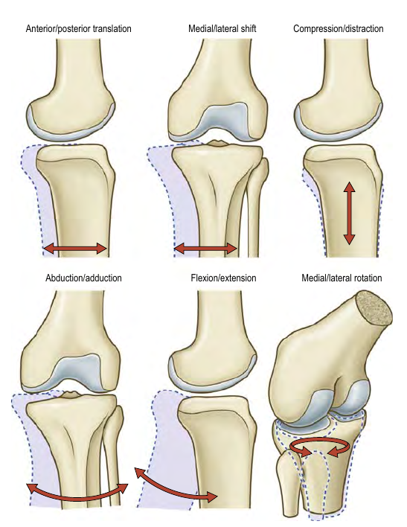
Tibiofemoral kinematics
Six Degrees of freedom
3 Rotations
Flexion-Extension: ~160°
Medial-Lateral: 25-30°
Abduction-Adduction: ~5°
3 Translations
Anterior-Posterior: 5-10 mm
Meidal-Lateral: 1-2 mm
Compression-Distraction: 2-5 mm
(Credit: Gray’s Anatomy 42nd ed.)
Jena | 25.10.2024 | Aayush Nepal
Notes:
If we can quantify any one of these motions accurately, then vital information might be revealed.

Slide 4
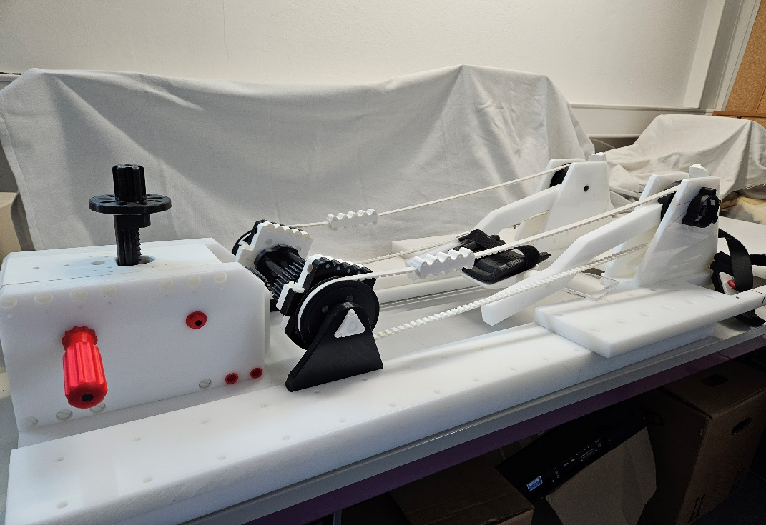
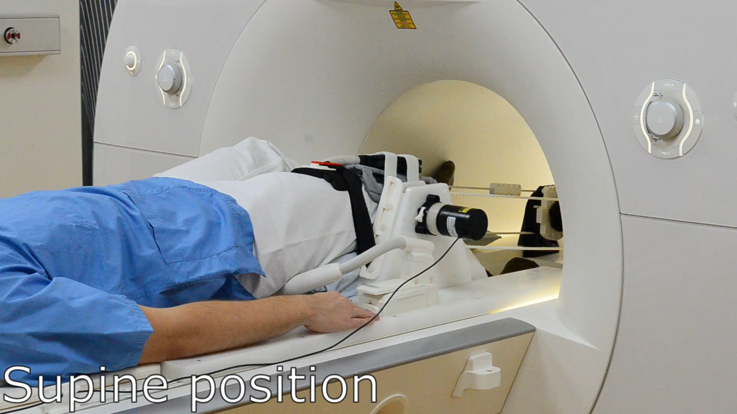

Knee flexion-extension device
Notes:
This device was developed (a few years ago) in collaboration with our partners at Charite Berlin

Slide 5
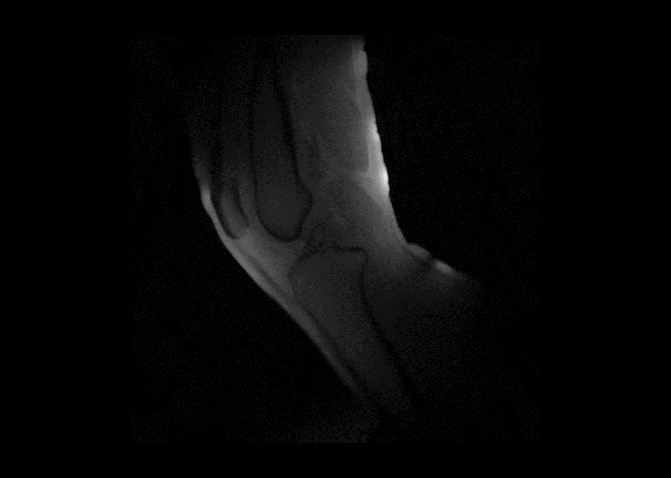
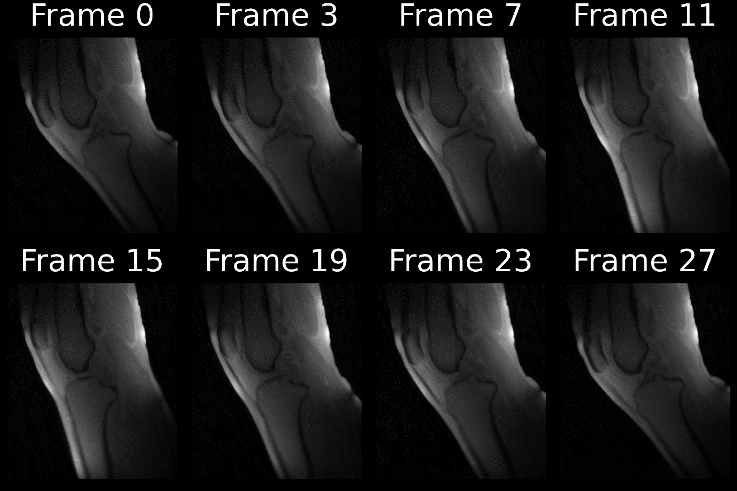
Reconstructed frames

Slide 6
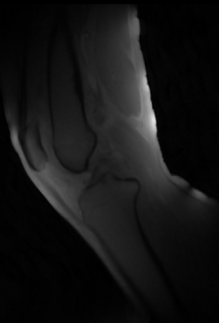
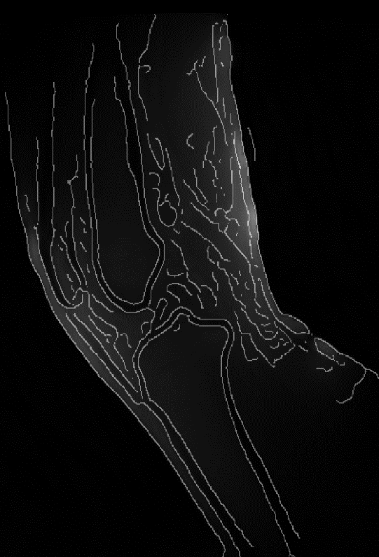
Methods: Edge Detection

Slide 7
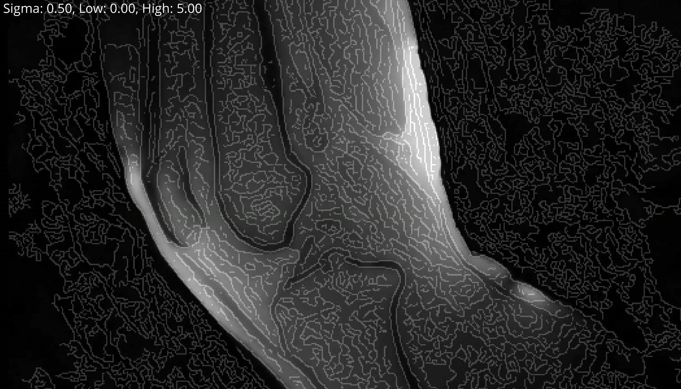
Methods: Edge Detection
Hystereses Thresholding (Pixels and their gradient magnitude)
Strength of gaussian blur
Low Threshold: lower values are discarded (not an edge)
High Threshold: values higher are ‘Strong Edges’
In Between: ‘Weak Edges’ Only kept if connected to a strong edge

Slide 8
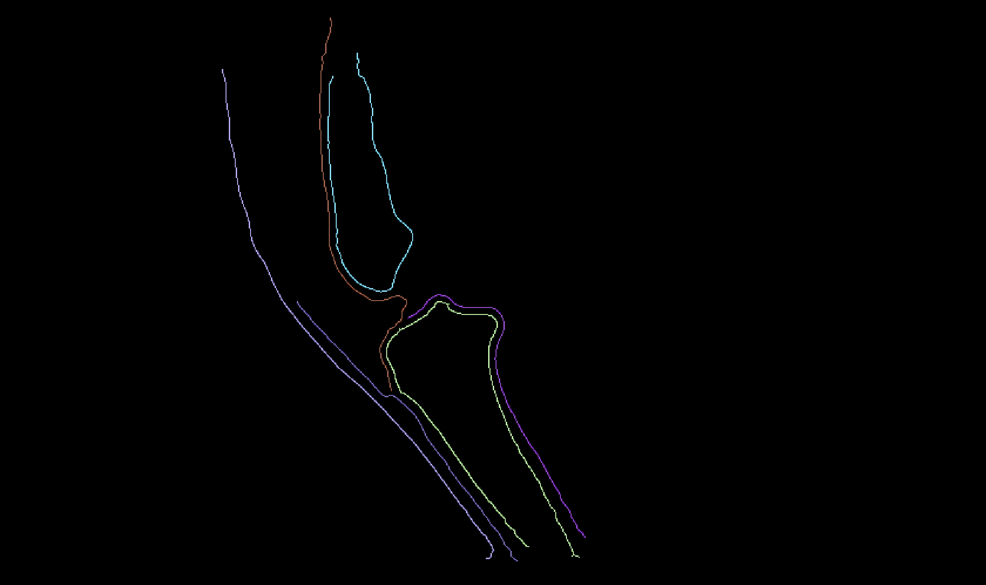
Methods: Connected Component Labelling
Jena | 25.10.2024 | Aayush Nepal

Slide 9
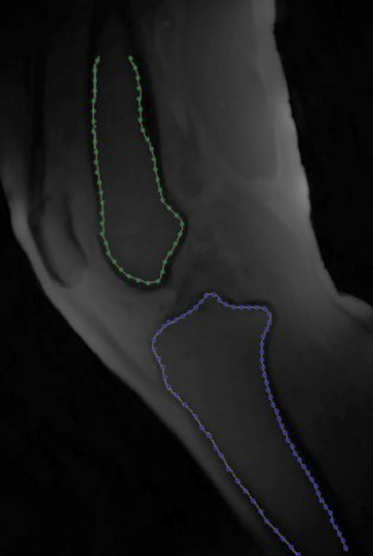
Methods: Downsample and sorting

Slide 10
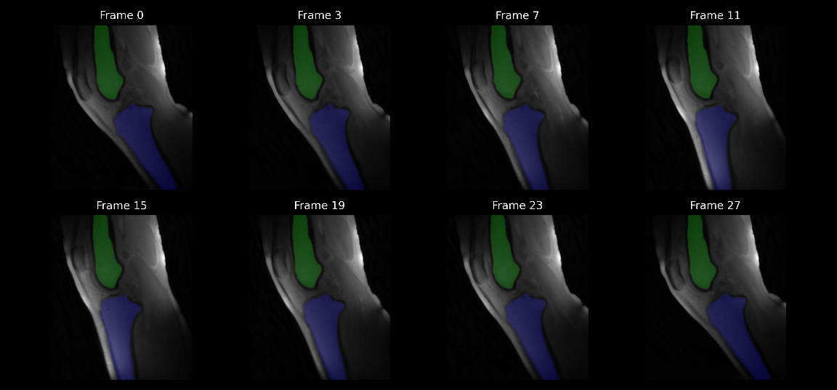
Methods: Applying transformation

Slide 11
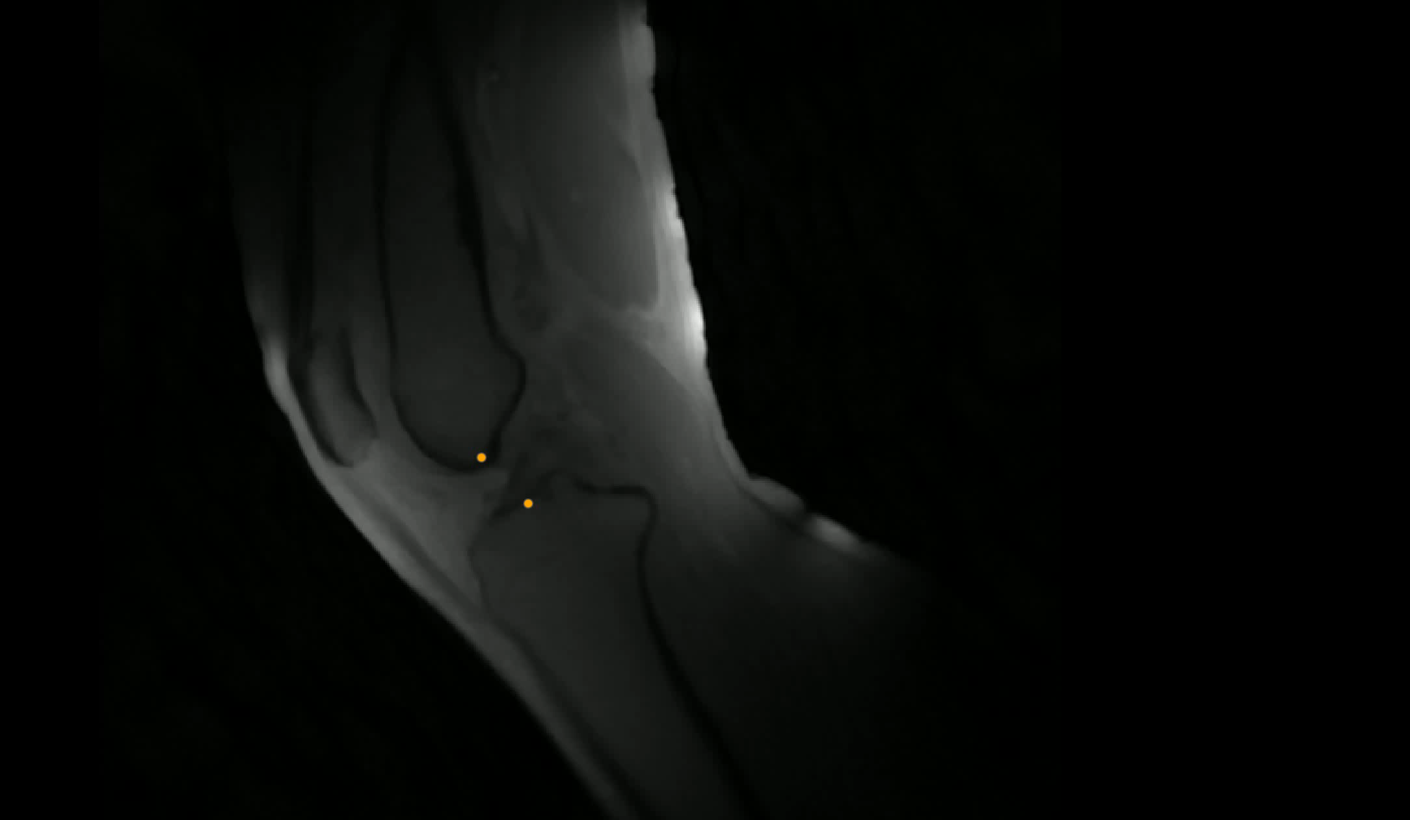
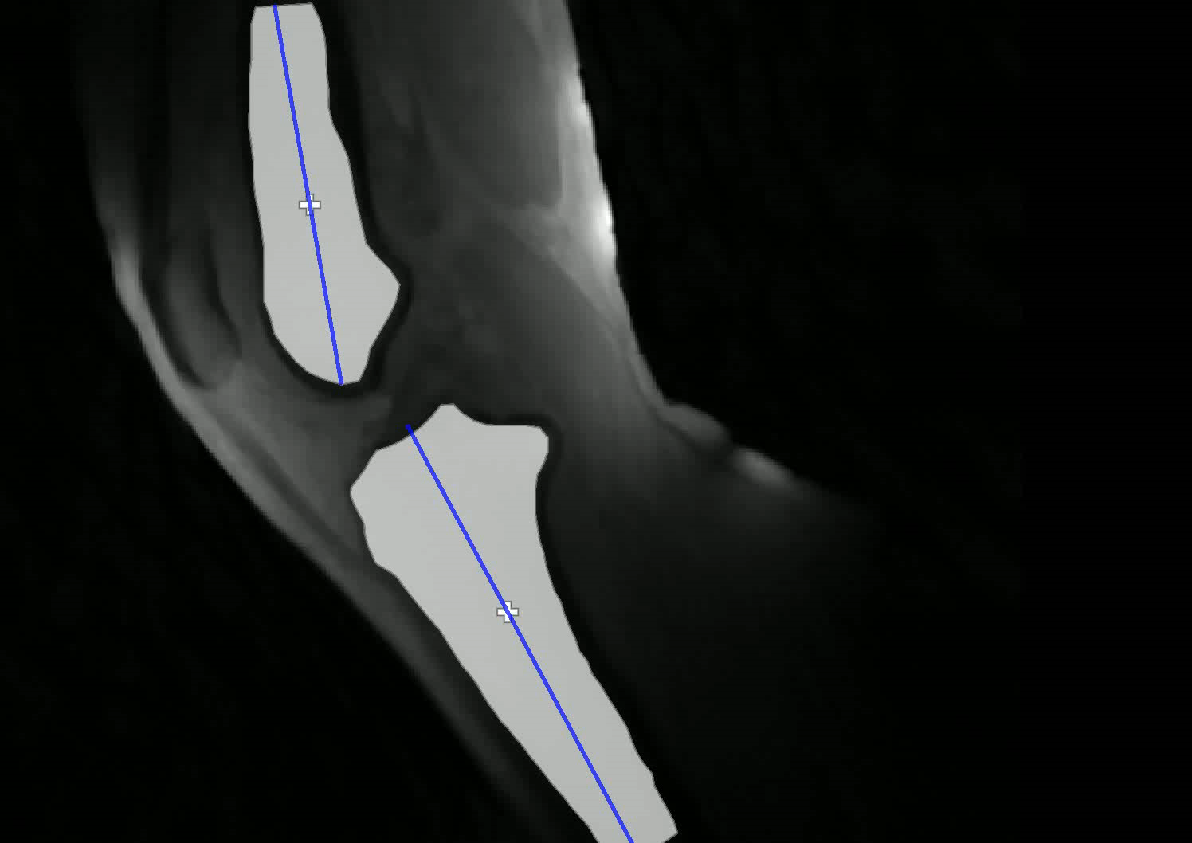
Parameter extraction and tracking
Jena | 25.10.2024 | Aayush Nepal

Slide 12
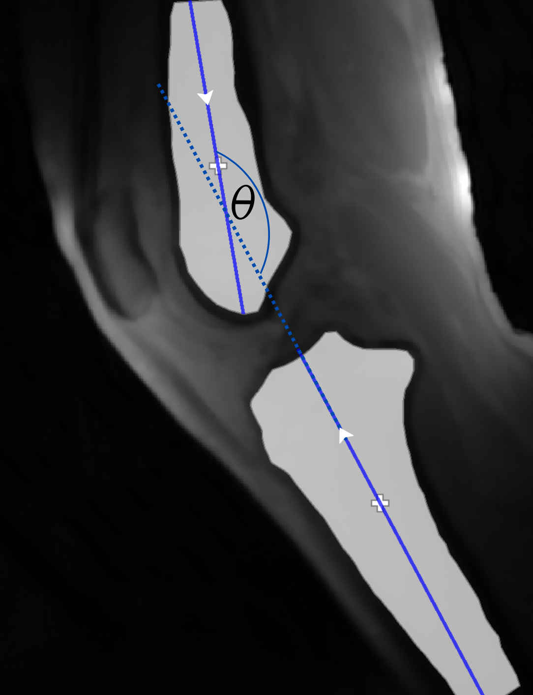
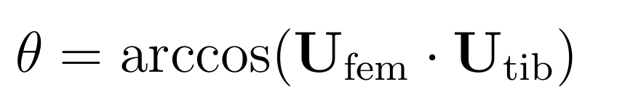
Method: Long axis using PCA
Jena | 25.10.2024 | Aayush Nepal

Slide 13
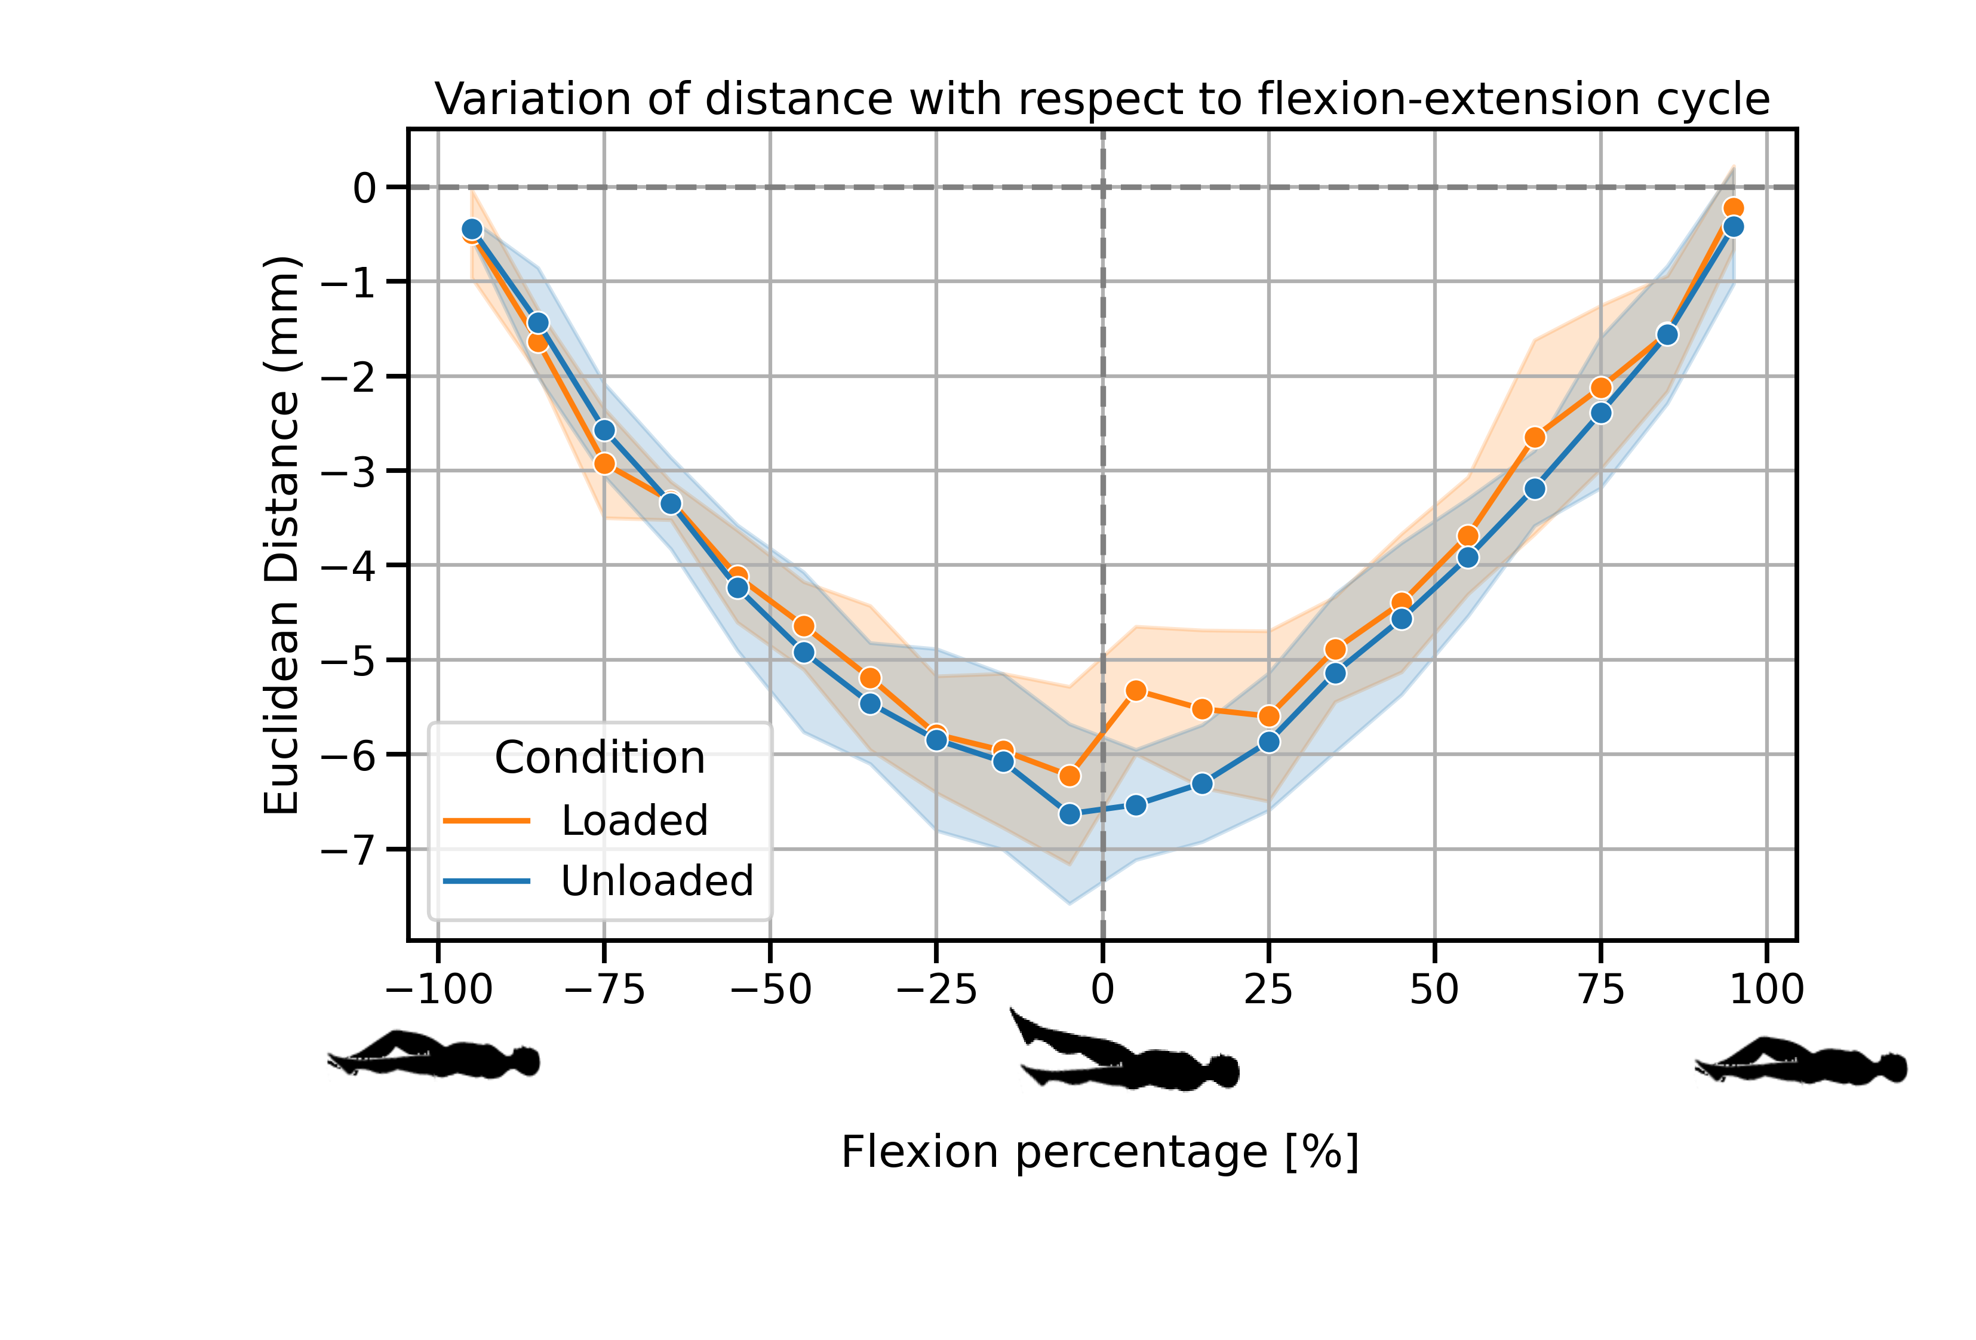
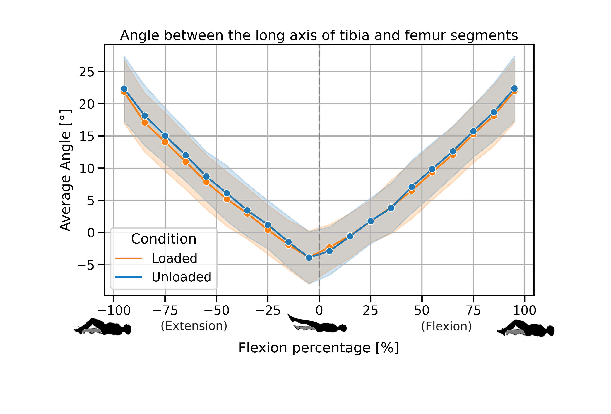
Results
Jena | 25.10.2024 | Aayush Nepal

Slide 14

Thank you for your attention!
Jena | 25.10.2024 | Aayush Nepal

Slide 15
Jena | 25.10.2024 | Aayush Nepal

Slide 16
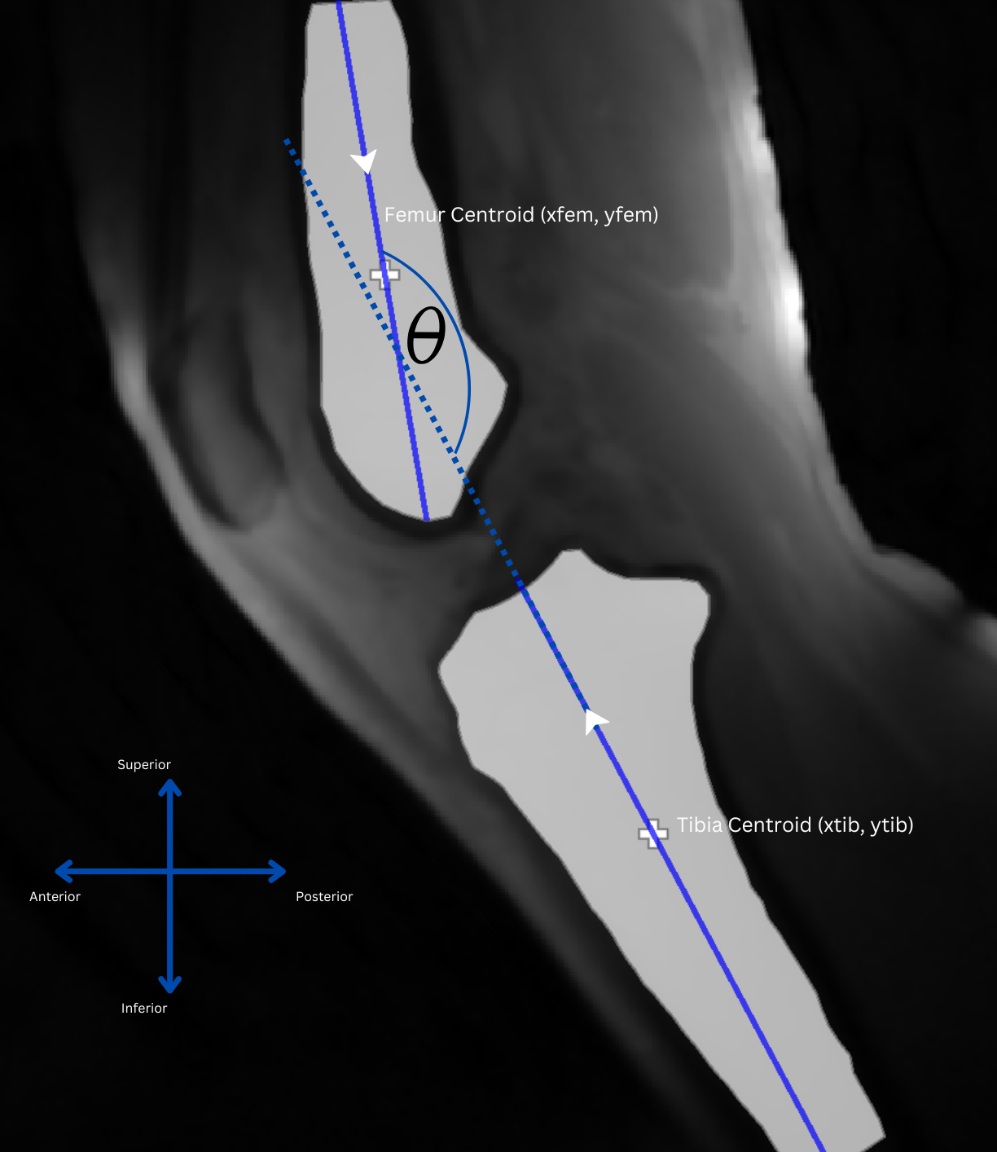
Supplementary materials
Jena | 25.10.2024 | Aayush Nepal

